Slide 1
AASCU RFY Project Update
June, 2018 (Year 2 of 3)
Dr. Tim Crowley, Associate Provost for Academic Affairs
Notes:
Tim, Greetings

Slide 2
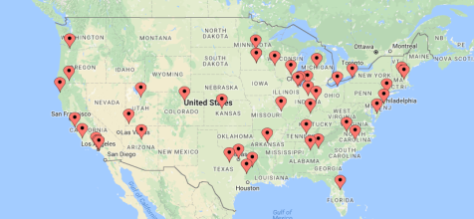
Re-imagining the First Year Project (RFY)
FHSU is part of 44 campuses across the country participating in a three year project to improve retention in the first year.

Slide 3
Project Organization
Organized into 4 “buckets” of work:
  Institutional Intentionality
  Curriculum
  Faculty
  Students
RFY Steering Committee – representatives from Academic and Student Affairs

Slide 4
Major Projects by Bucket
Institutional Intentionality – Starfish predictive analytics, student success center, comprehensive advising reform, new general education program
Curriculum – co-requisite remediation, reducing DUWI rates, gateway course improvement
Faculty – faculty & staff development social belonging
Students – improved early alert usage, 2nd year learning communities

Slide 5
RFY Metrics
Credit Accumulation – total of all credit earned by first-time full-time cohort in first year
Credit Completion – ratio of courses passed with grade of D or better by 1st year cohort in first year
Gateway Course Completion – Success rates of first year cohort in 5 highest enrollment first year courses
Persistence (Fall to Fall) – traditional IPEDS number
Major Selection Percentage – percentage of first year students selecting a major by end of first year.

Slide 6
Our Results (Year 2)

Slide 7
Gateway Course Metrics

Slide 8
Discussion
Metric #1 improvement was .8% - target is 5%
Metric #2 improvement was -1.1% - target is 5%
Metric #3 improvement was -.5% - target is -5%.
Metric #4 – results will be known at census day in Fall, 2018
Metric #5 - results will be measured at census day in Fall, 2018

Slide 9
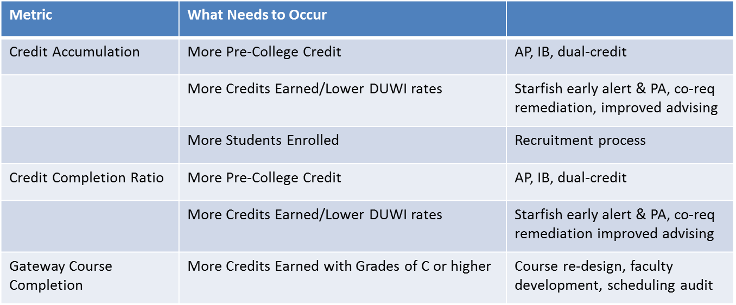
Moving the Needles

Slide 10
RFY Steering Committee
Tim Crowley
Jeff Briggs
Joey Linn
Sangki Min
Brett Bruner
Patti Griffin
Dennis King
Teresa Clounch
Dosse Toulaboe
Jill Arensdorf
Keith Dreiling
Andrew Feldstein

