Slide 1
A Social Belonging Faculty Development Intervention
Dr. Tim Crowley, Associate Provost for Academic Affairs
Dr. Andrew Feldstein, Assistant Provost for Teaching Innovation and Learning Technologies
Notes:
Tim, Greetings

Slide 2
RFY Context
Institutional Intentionality
Students
Classroom
Faculty
Curriculum

Slide 3
Overall Retention Data Trends

Slide 4
Underrepresented DUWI rate – Top 10 freshman courses - 2016
2016 First-Time Full-Time Cohort
Rank | Course | All Enrollments | DUWI % | Underrepresented Enrollments | Underrepresented DUWI % | White Enrollments | White DUWI % | DUWI Gap %
1 | HHP 200 | 766 | 16.19 | 167 | 25.15 | 595 | 13.61 | 11.54
2 | ENG 101 | 523 | 21.8 | 145 | 18.62 | 373 | 23.06 | +4.44
3 | INF 101 | 473 | 19.45 | 94 | 27.65 | 377 | 14.59 | 13.06
4 | GSCI 110 | 457 | 18.6 | 92 | 33.7 | 363 | 14.6 | 19.1
5 | ENG 102 | 400 | 13.5 | 90 | 15.56 | 306 | 12.09 | 3.47
6 | COMM 100 | 339 | 13.86 | 87 | 20.69 | 249 | 11.24 | 9.45
7 | PSY 100 | 305 | 21.97 | 81 | 33.33 | 223 | 17.49 | 15.84
8 | BIOL 100 | 250 | 25.2 | 58 | 34.48 | 190 | 22.11 | 12.37
9 | MATH 110 | 221 | 38.01 | 45 | 42.22 | 175 | 36.57 | 5.65
10 | BIOL 102 | 212 | 26.42 | 47 | 46.81 | 163 | 20.25 | 26.56
 | Mean |  | 21.50 |  | 29.82 |  | 18.56 | 11.26

Slide 5
Underrepresented DUWI rate – Top 10 freshman courses - 2017
2017 First-Time Full-Time Cohort
Rank | Course | All Enrollments | DUWI % | Underrepresented Enrollments | Underrepresented DUWI % | White Enrollments | White DUWI % | DUWI Gap %
1 | HHP 200 | 795 | 17.23 | 189 | 25.4 | 604 | 14.57 | 10.83
2 | GSCI 110 | 545 | 17.98 | 124 | 27.42 | 420 | 15.24 | 12.18
3 | INF 101 | 542 | 17.53 | 116 | 21.55 | 424 | 16.51 | 5.04
4 | ENG 101 | 528 | 21.02 | 180 | 27.78 | 347 | 17.58 | 10.2
5 | ENG 102 | 403 | 13.9 | 107 | 19.63 | 295 | 11.86 | 7.77
6 | COMM 100 | 359 | 16.99 | 97 | 23.71 | 260 | 14.62 | 9.09
7 | PSY 100 | 327 | 20.80 | 110 | 31.82 | 217 | 15.21 | 16.61
8 | HIST 111 | 300 | 28 | 68 | 29.41 | 232 | 27.59 | 1.82
9 | BIOL 100 | 260 | 21.15 | 73 | 31.51 | 187 | 17.11 | 14.4
10 | MATH 110 | 256 | 39.45 | 53 | 30.19 | 203 | 41.87 | +11.68
 | Mean |  | 21.41 |  | 26.84 |  | 19.22 | 7.63

Slide 6
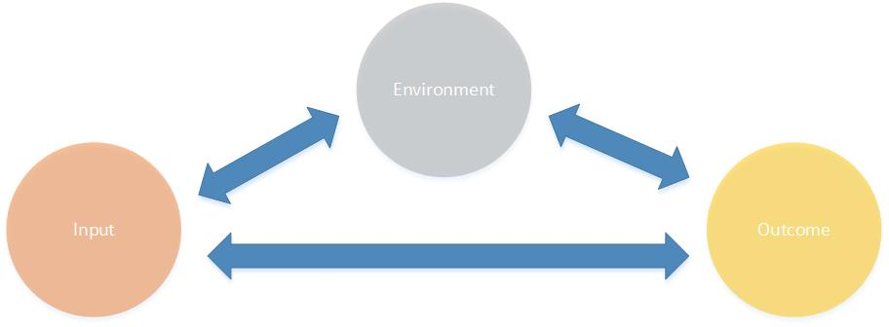
The IEO Model
Incentivized Social Belonging Training
Mean UR Top Ten DUWI rate =29.8%
-2% per year

Slide 7
Project Sequence
Phase | Description | Notes
1 – Organization | Make the case for change Recruit task force Identify Stakeholders Align resources Build relationships | RFY provided context for a multi-office, cross-divisional effort to succeed
2 - Development | Design framework Produce compelling content Test for effectiveness | Collaborative team effort with leadership provided by TILT unit
3 - Execution | Participant Recruitment Dept. Chair/Dean Communication Project Launch (3 weeks) Concluding Reflection | Target group = ~50 faculty Supplemental salary incentives = $150 Training administered fall and spring

Slide 8
Key Stakeholders
Provost’s office | Teaching Innovation and Learning Technologies
Diversity and Inclusion | Institutional Effectiveness and Quality Improvement
Dept. of Biological Sciences | Department of English
Dept. of Communication Studies | Department of Health and Human Performance
Dept. of Informatics | Department of Mathematics
Dept. of Geosciences | 2018 First-Time Full-Time Freshman Cohort

Slide 9
Project Team
Dr. Tim Crowley, Associate Provost Dr. Andrew Feldstein, Assistant Provost TILT Nicole Frank, Faculty Development Specialist Valerie Brown-Kuchera, Faculty Development Specialist Nathan Riedel, Video Specialist Dr. Gulinna A, Instructional Designer Taylor Kriley, Director of Diversity and Inclusion | Dr. Rob Channell, Chair, Biology Dr. James Austin, English Dr. Rose Helens-Hart, Applied Business Studies Dr. Keith Dreiling, Chair, Mathematics Dr. Jill Arensdorf, Chair, Leadership Studies Dr. Hsin-Yen Yang, Communication Dr. Trey Hill, Chair, Psychology Dr. Whitney Jeter, Psychology

Slide 10
Intervention Learning Outcomes
Upon completion of the training modules for this project, faculty/staff members will:
identify challenges faced by underrepresented students in contemporary higher education.
identify personal assumptions of cultural differences.
predict ways in which verbal and non-verbal communication used in class presentation, discussion, and evaluation of student work may impact social belonging by underrepresented students.
construct sample feedback messages and terminology to all students that affirm social belonging.
interpret common signs of educational disengagement in underrepresented students.
develop strategies for identifying student engagement.

Slide 11
Demonstration
Faculty Development Social Belonging Project

Slide 12
Social Belonging Intervention: Preliminary Results
Survey Data on First Group to Participate in Workshop

Slide 13
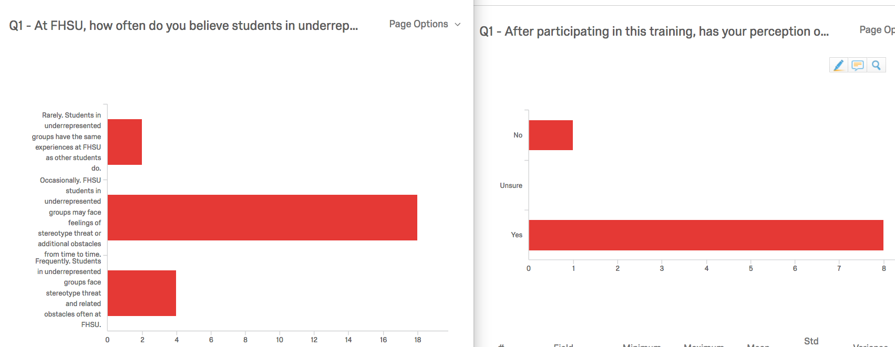
Q1 - At FHSU, how often do you believe students in underrepresented groups face stereotype threat or related obstacles that other students do not?

Slide 14
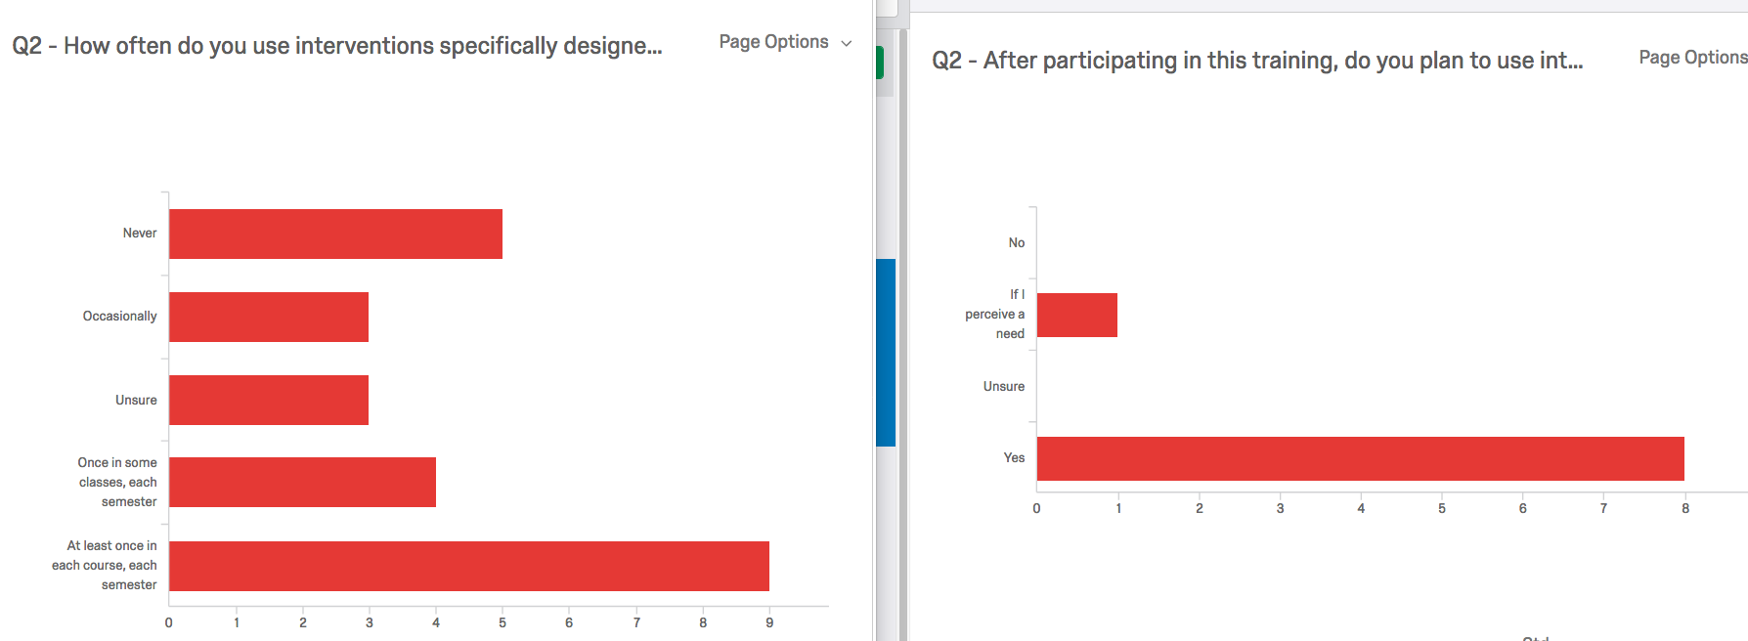
Q2 - How often do you use interventions specifically designed to promote a positive cultural climate in your classroom (examples might be getting-to-know-you surveys or affirmative values freewriting)?

Slide 15
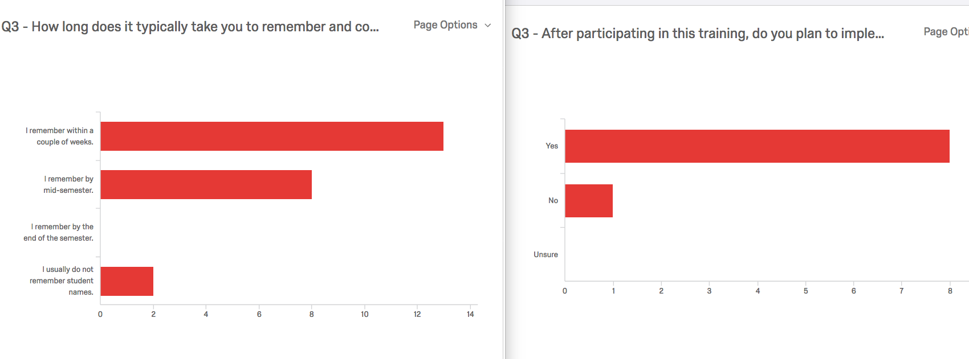
Q3 - How long does it typically take you to remember and correctly pronounce student names in your classes?

Slide 16
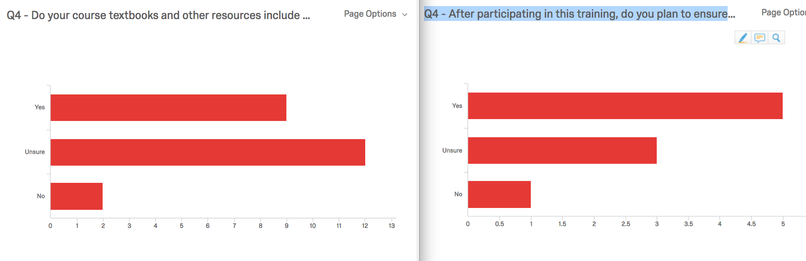
Q4 - Do your course textbooks and other resources include material written or created by people of different backgrounds?

Slide 17
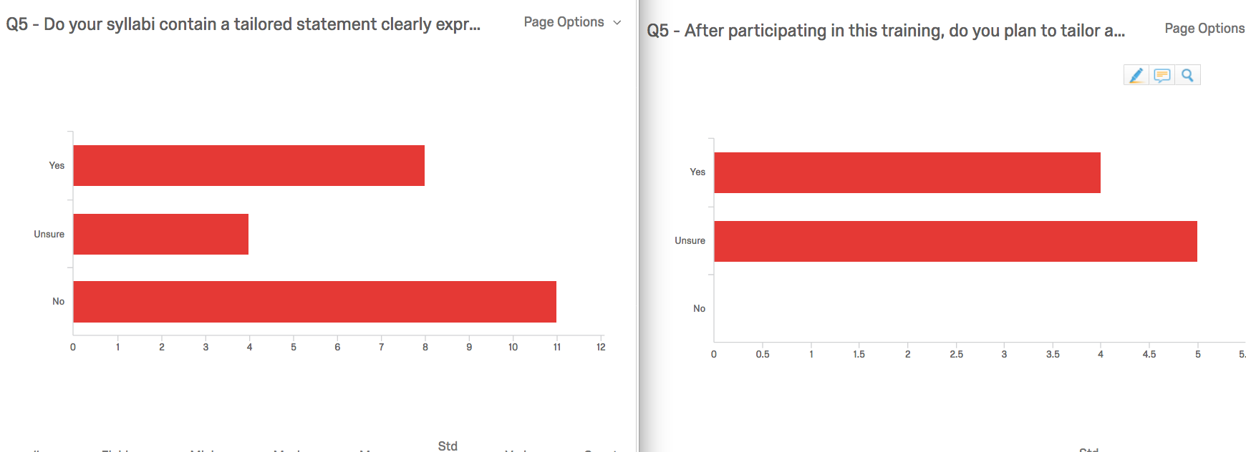
Q5 - Do your syllabi contain a tailored statement clearly expressing that equity and diversity are a part of your classroom values?

Slide 18
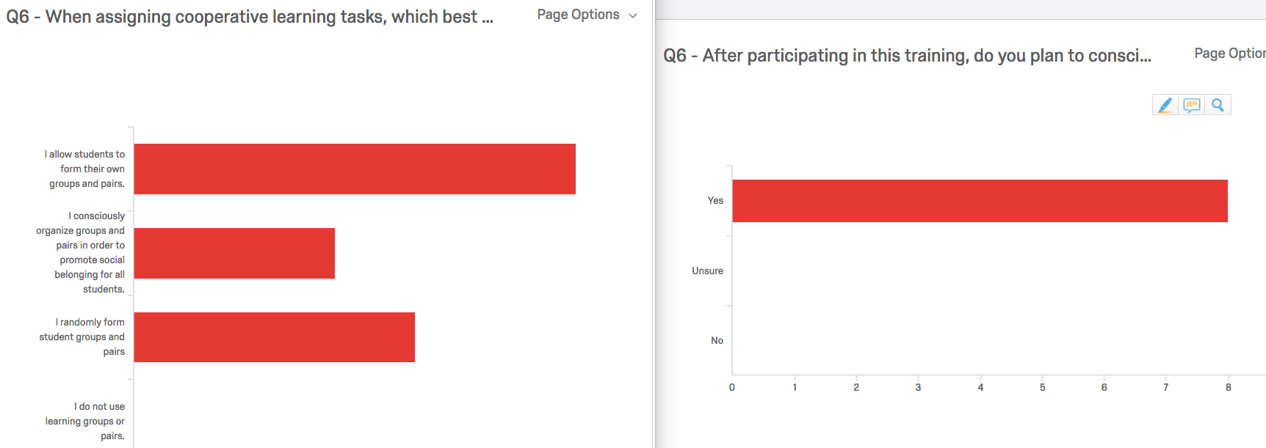
Q6 - When assigning cooperative learning tasks, which best describes your approach?

Slide 19
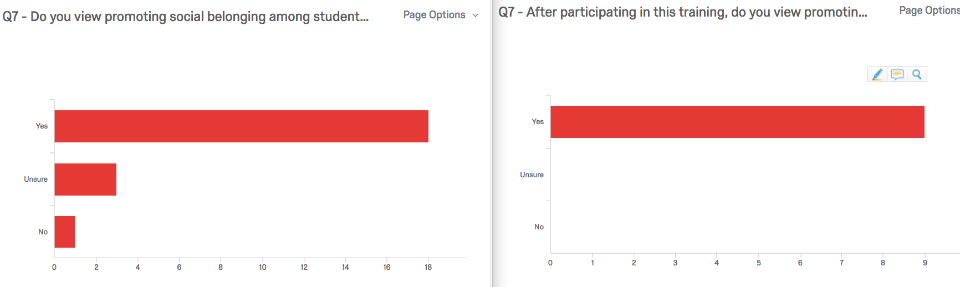
Q7 - Do you view promoting social belonging among students at FHSU as an important instructor responsibility?

Slide 20
Comments within the F18 Course
Level | # of Users Completing | # of Comments Given
1 | 11 | 48
2 | 10 | 36
3 | 9 | 52
4 (additional resources) |  | 51

Slide 21
Observations on F18 Course Comments
Great stories shared
Enthusiasm around workshop examples and shared ideas
Participants read and reacted to one another’s comments in positive and constructive ways.
Most discussed themes
  Challenges specific to math and English
  Group Formation
  Teaching Strategies
  A Gen Ed perspective

Slide 22
What We Learned From F18 Workshop
The FHSU specific content and examples make this workshop ‘personal and participants find them to be are powerful and effective.
Tighten certain design elements- make sure all levels and gates work as planned
Managing the course- More closely moderate the discussion to identify potential issues early and respond in a timely way to minimize participant frustration
Review Pre/Post Test process
Consider a summary deliverable from participants

Slide 23
Questions?
Thank you!

